Slide 1
Robustness Check of Traction Controll
Tsuyoshi SOGA 2023/07/28

Slide 2
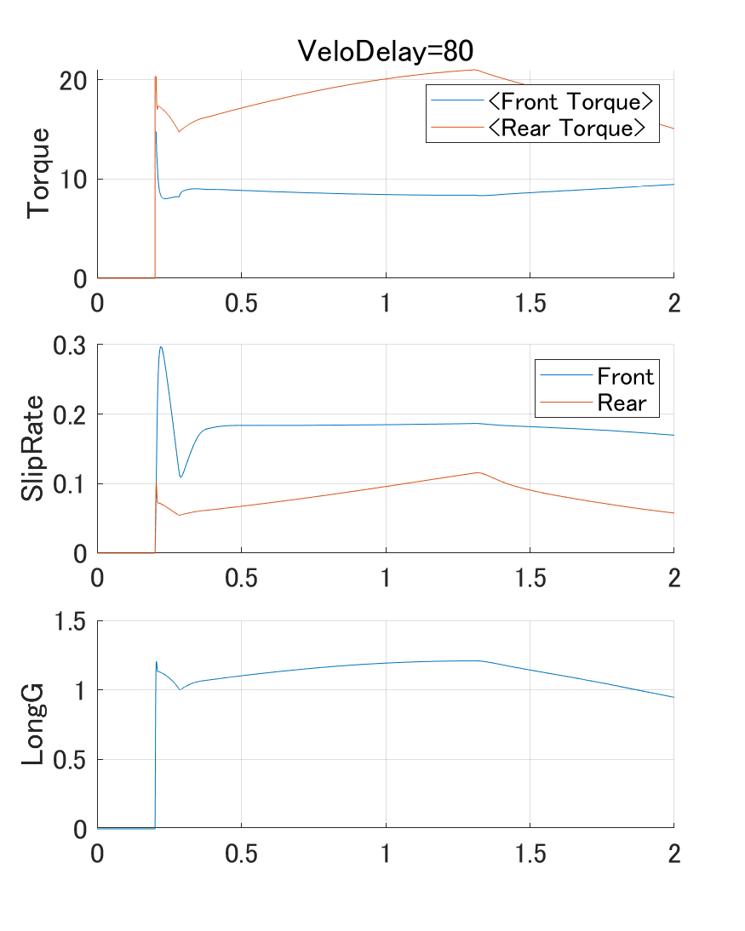
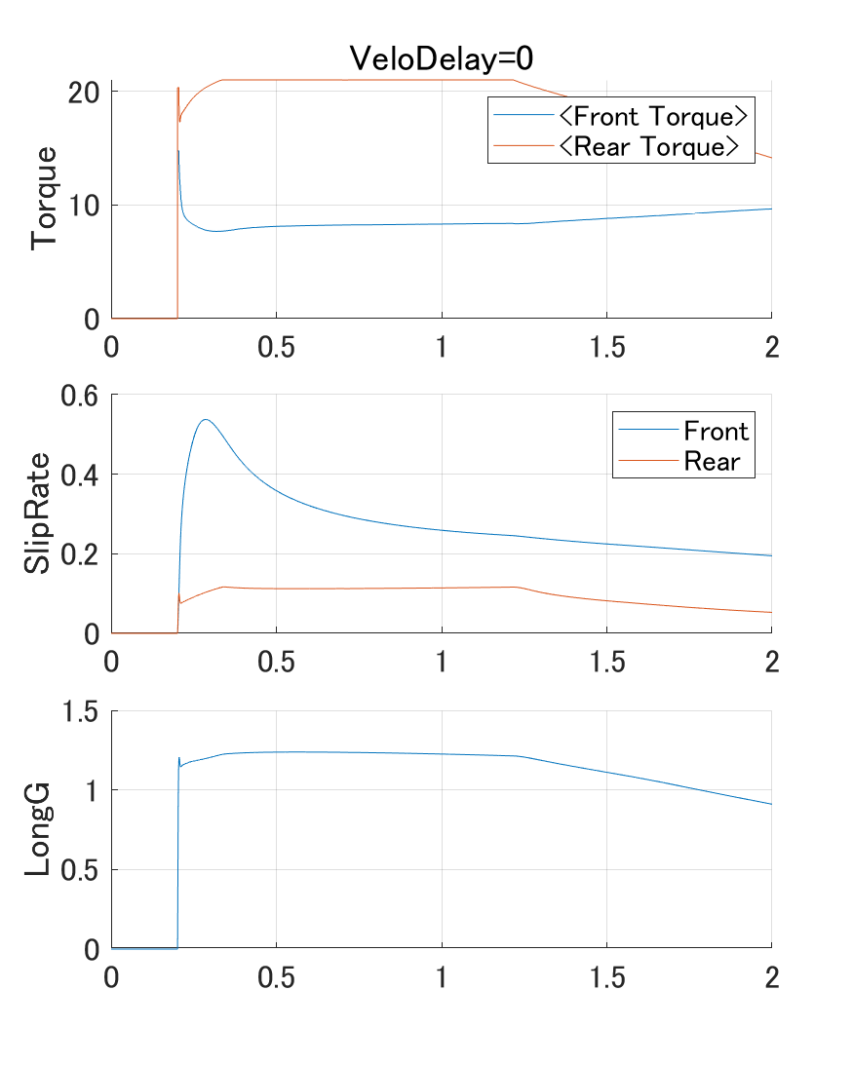
VeloDelay=0

Slide 3
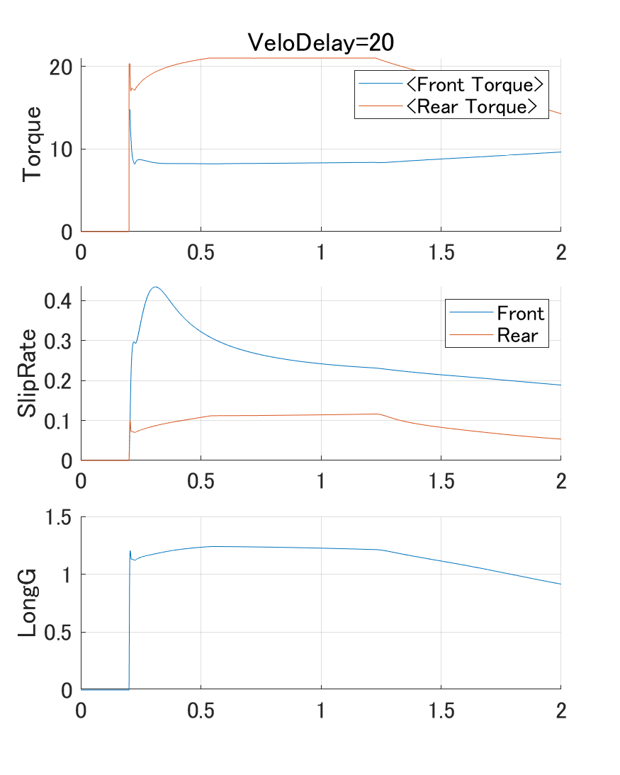
VeloDelay=20

Slide 4
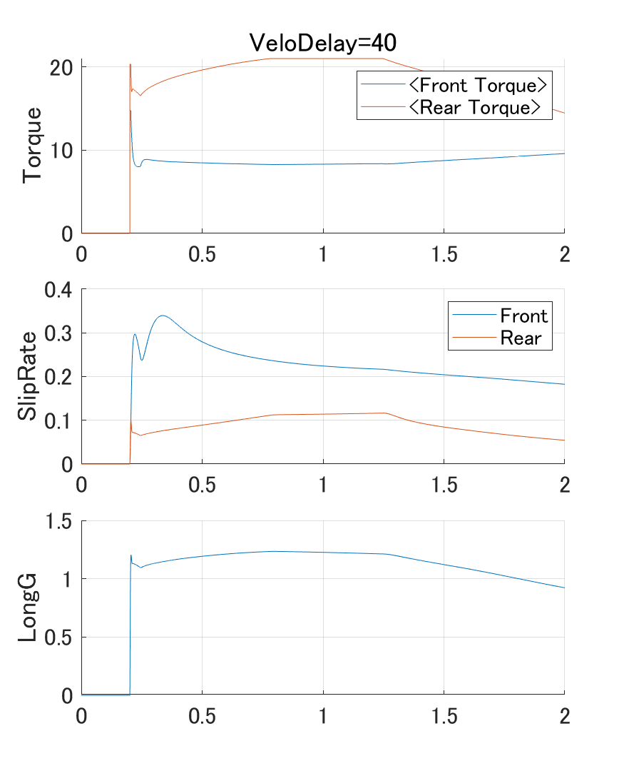
VeloDelay=40

Slide 5
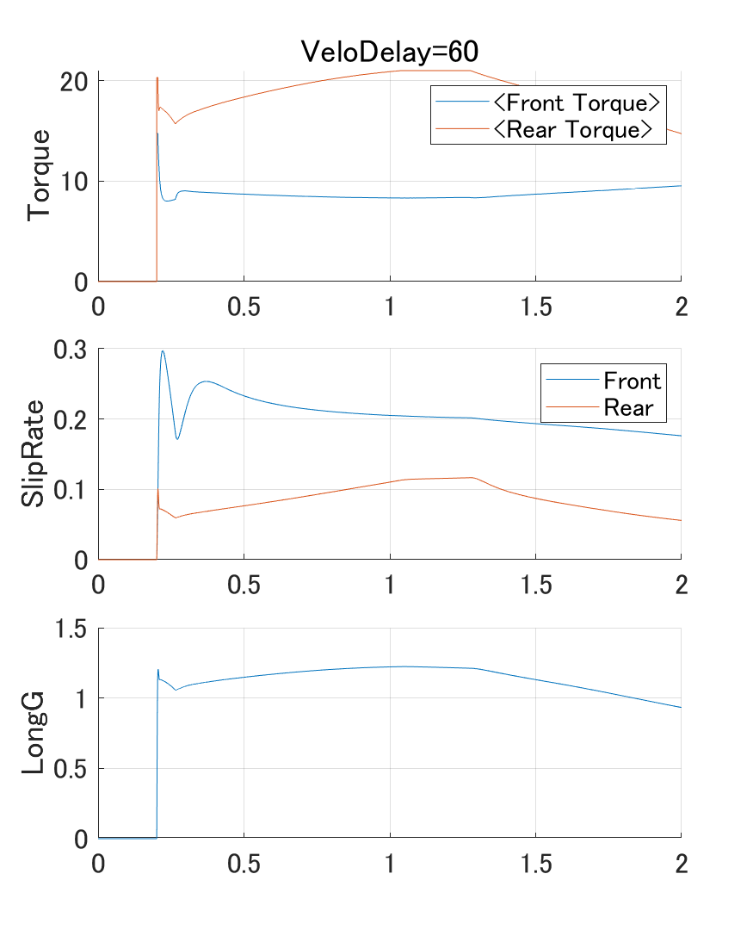
VeloDelay=60

Slide 6
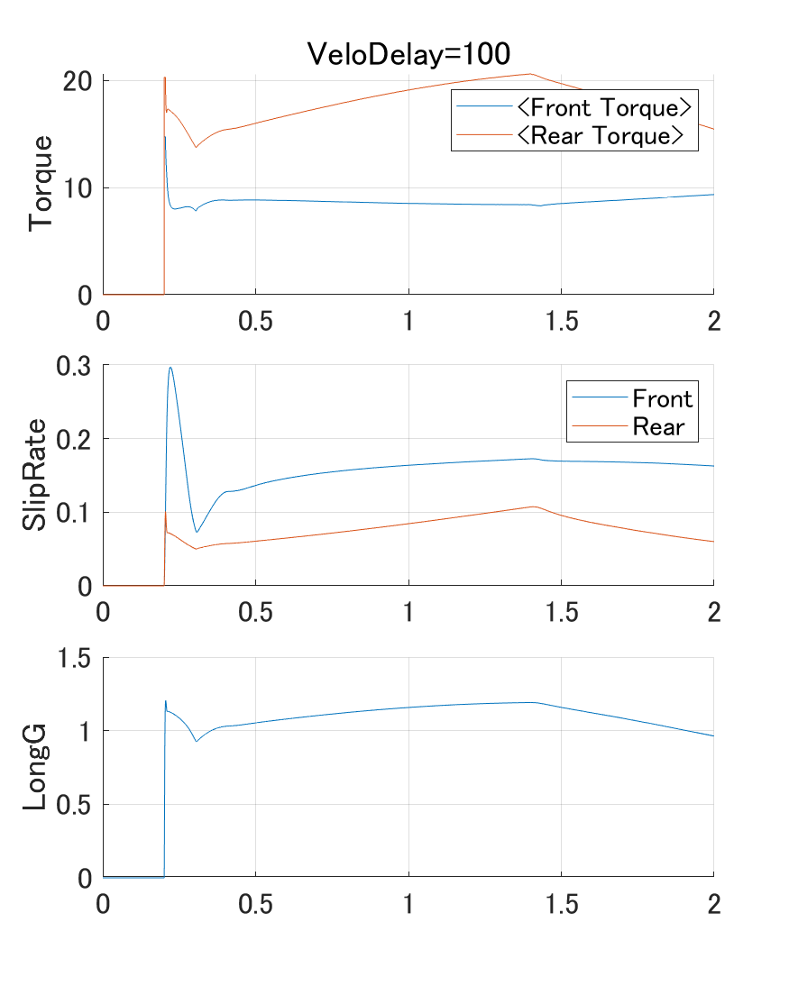
VeloDelay=100

Slide 7
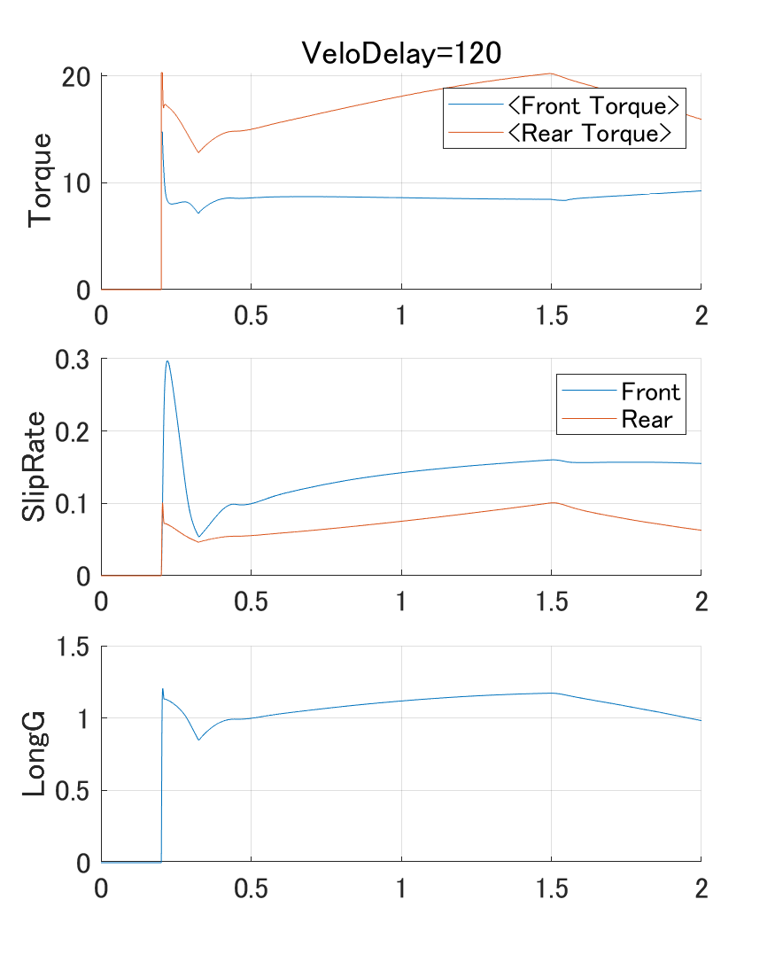
VeloDelay=120

Slide 8
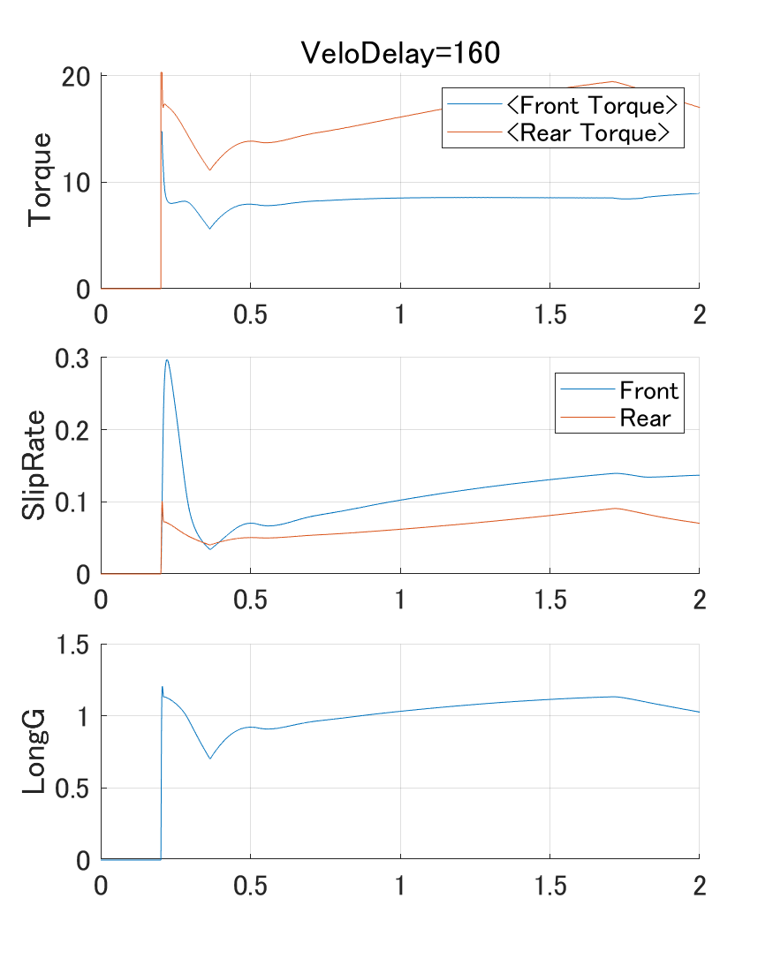
VeloDelay=160

Slide 9
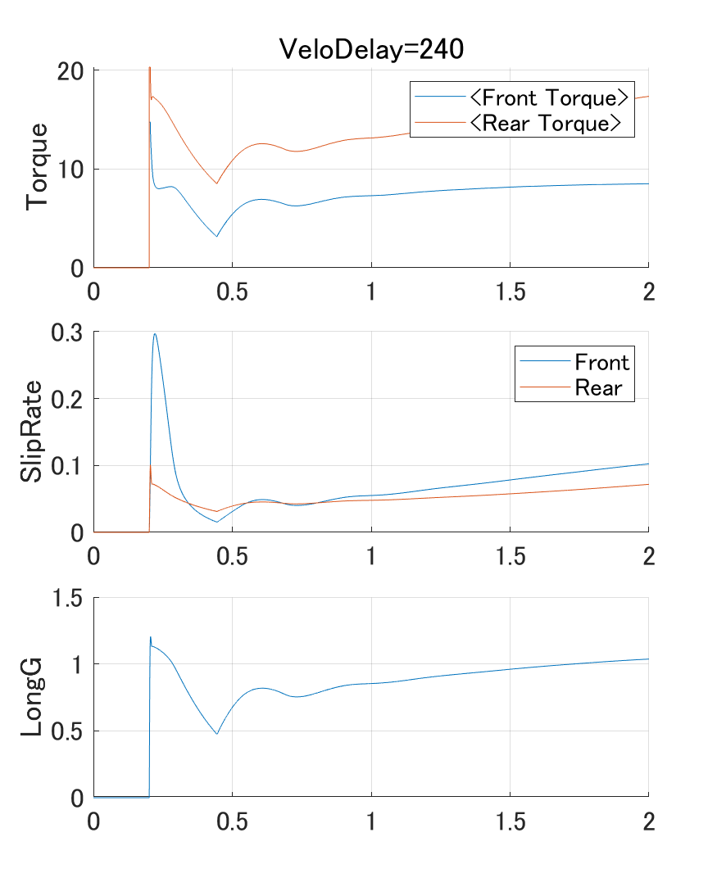
VeloDelay=240

Slide 10
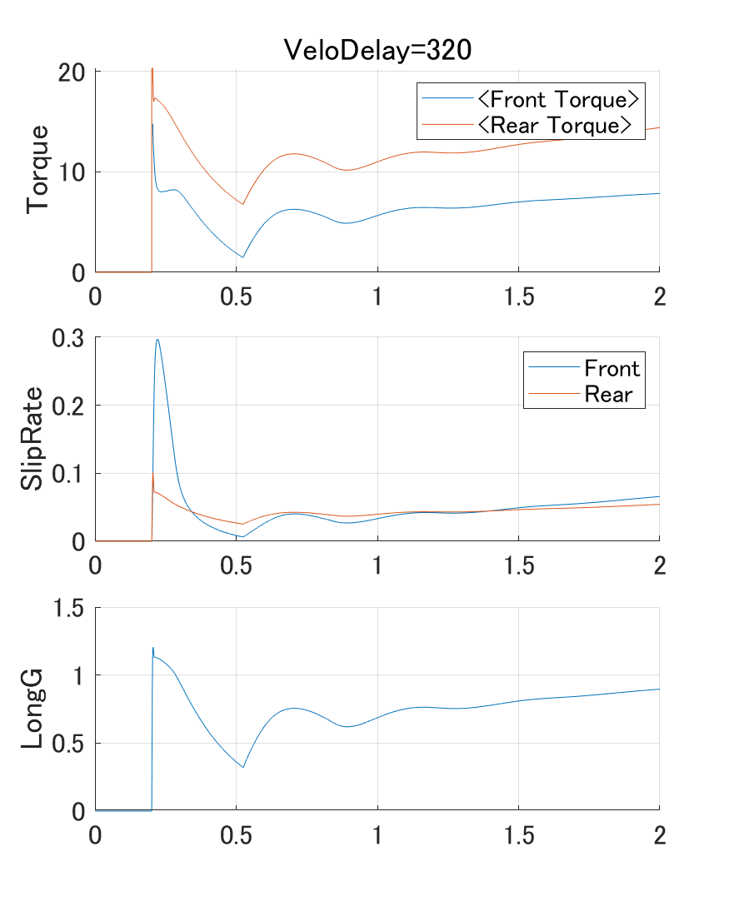
VeloDelay=320

Slide 11
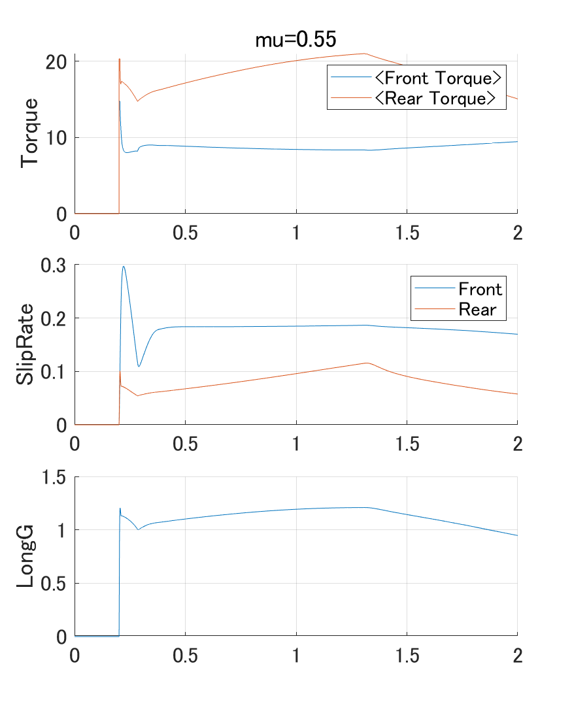
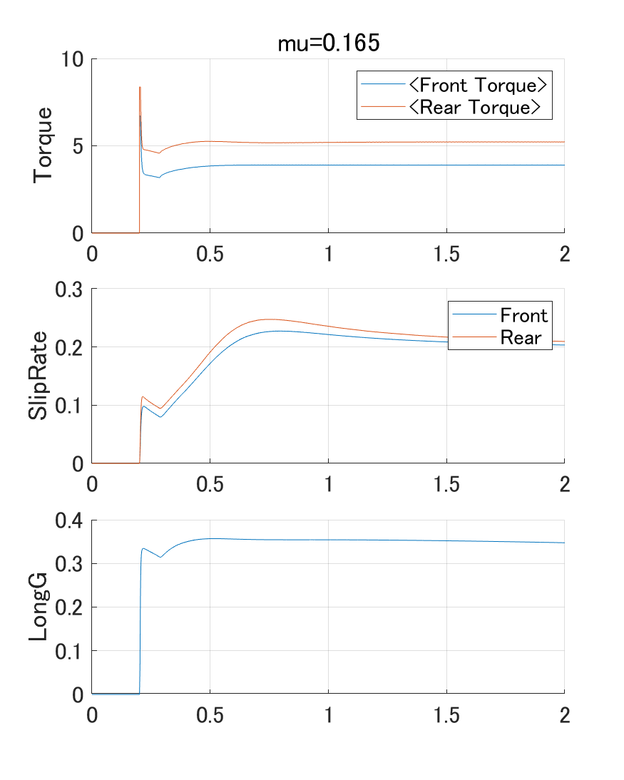
mu difference x0.3

Slide 12
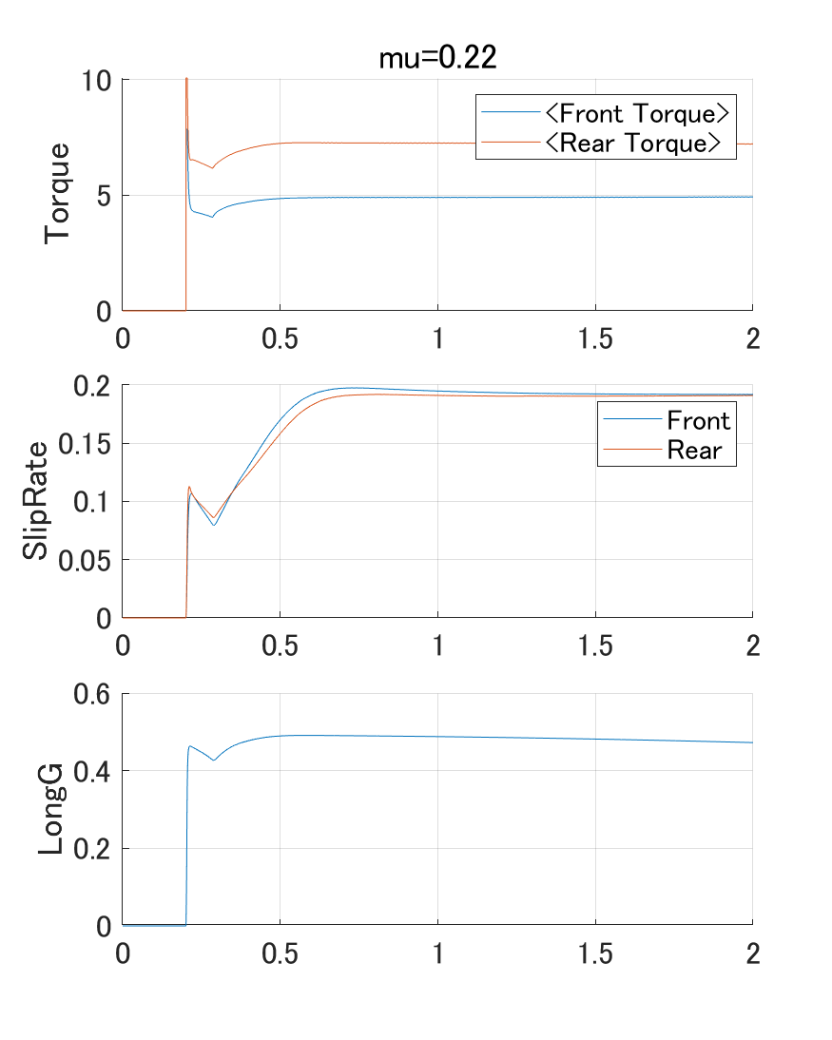
mu difference x0.4

Slide 13
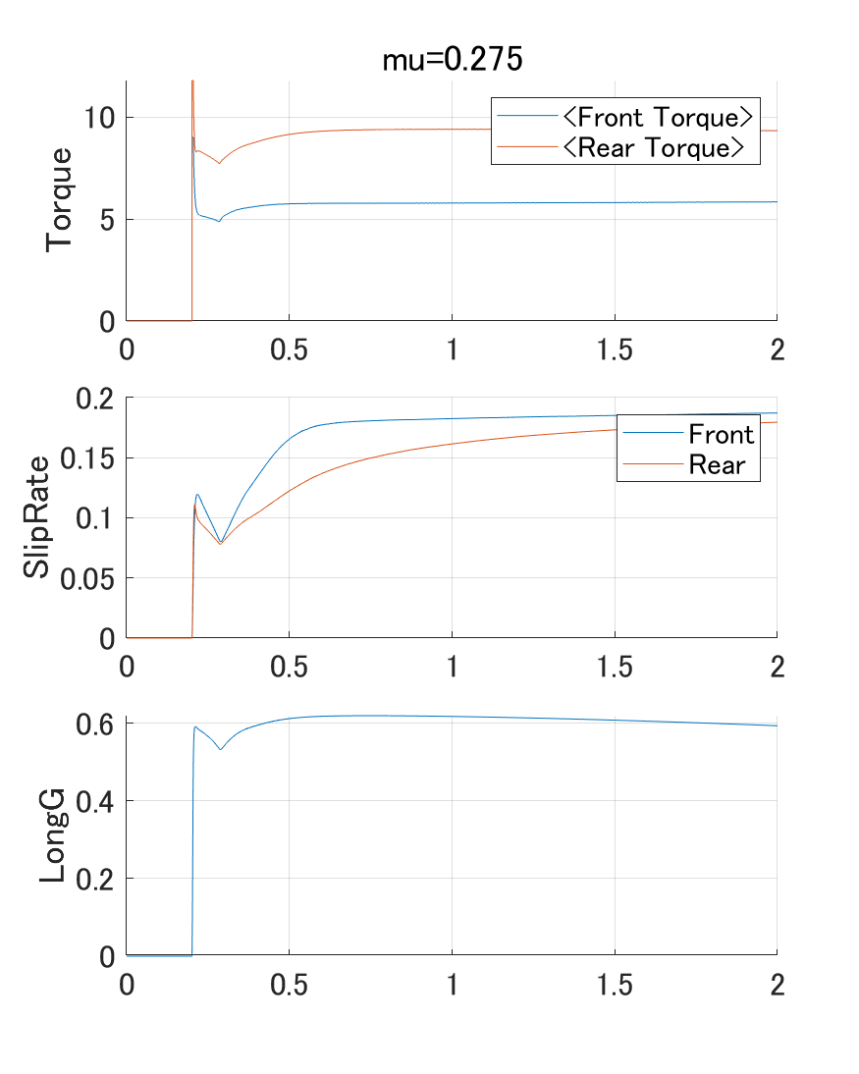
mu difference x0.5

Slide 14
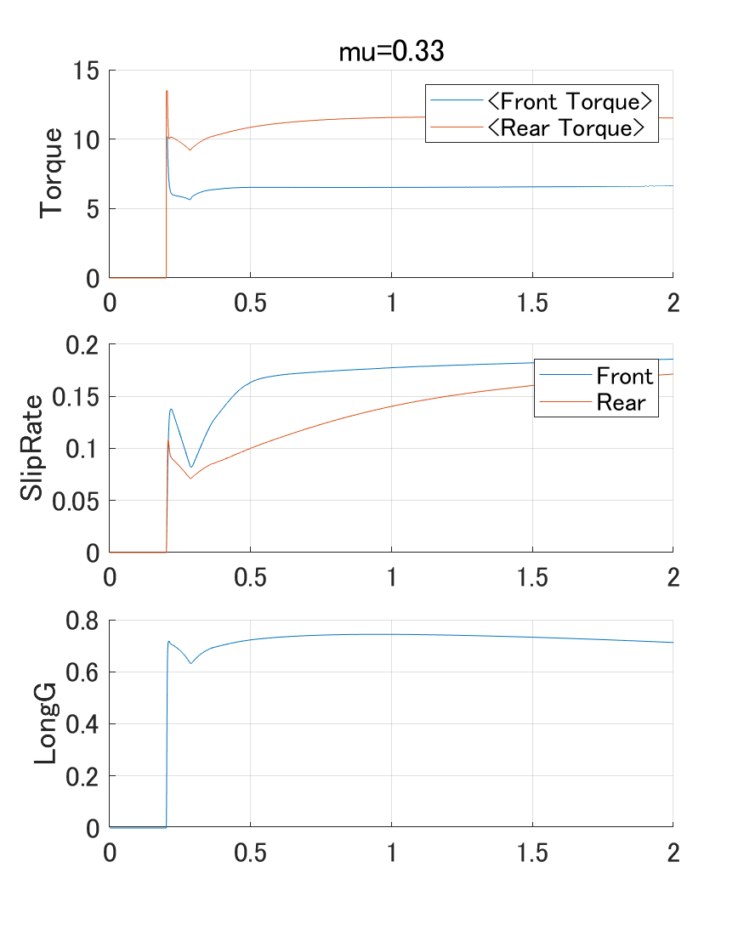
mu difference x0.6

Slide 15
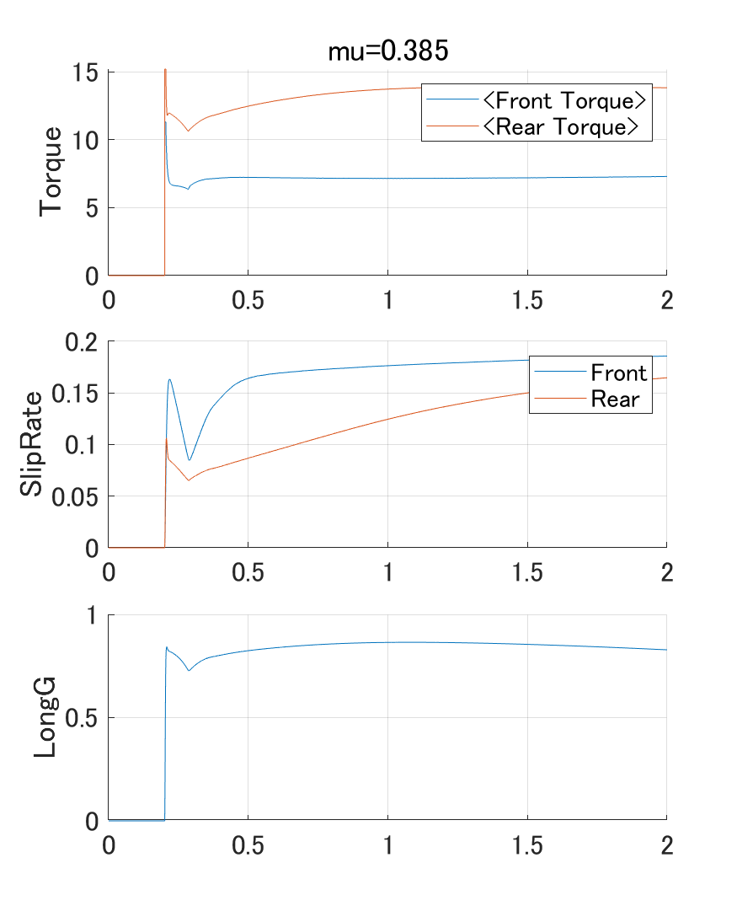
mu difference x0.7

Slide 16
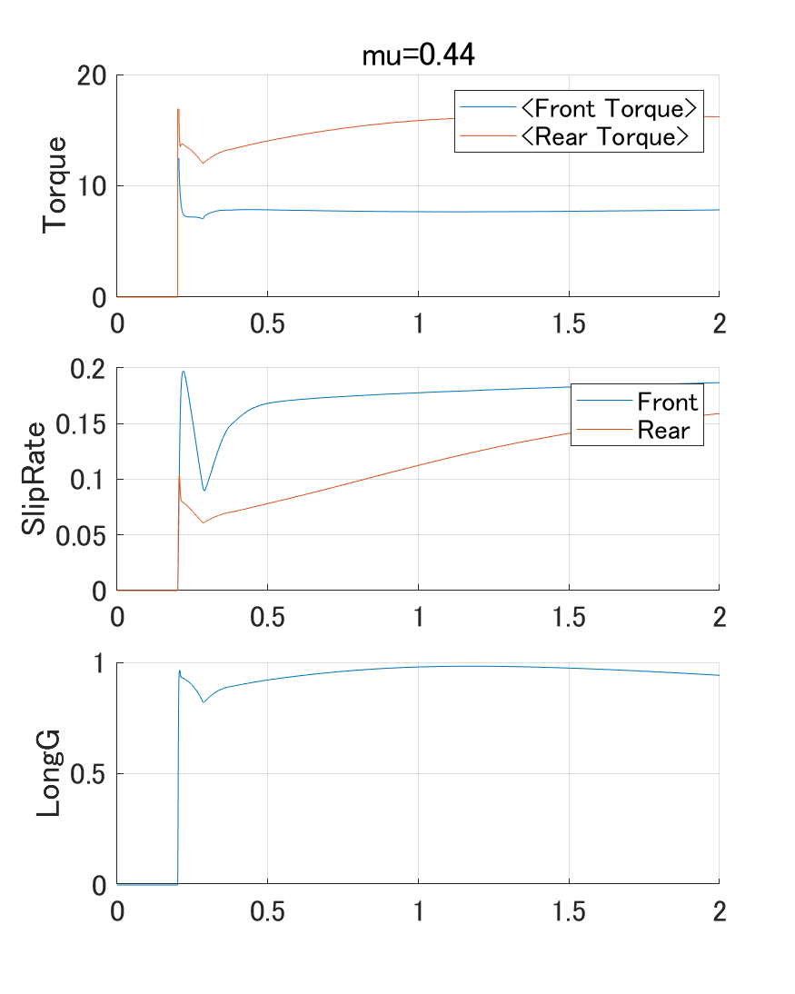
mu difference x0.8

Slide 17
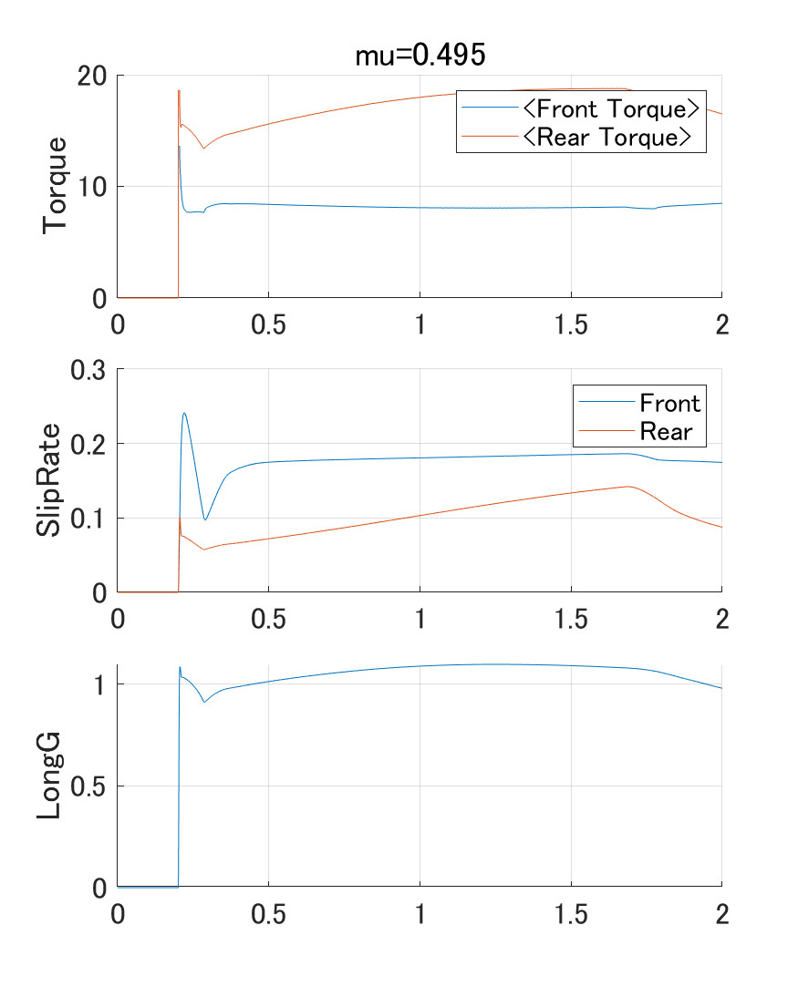
mu difference x0.9

Slide 18
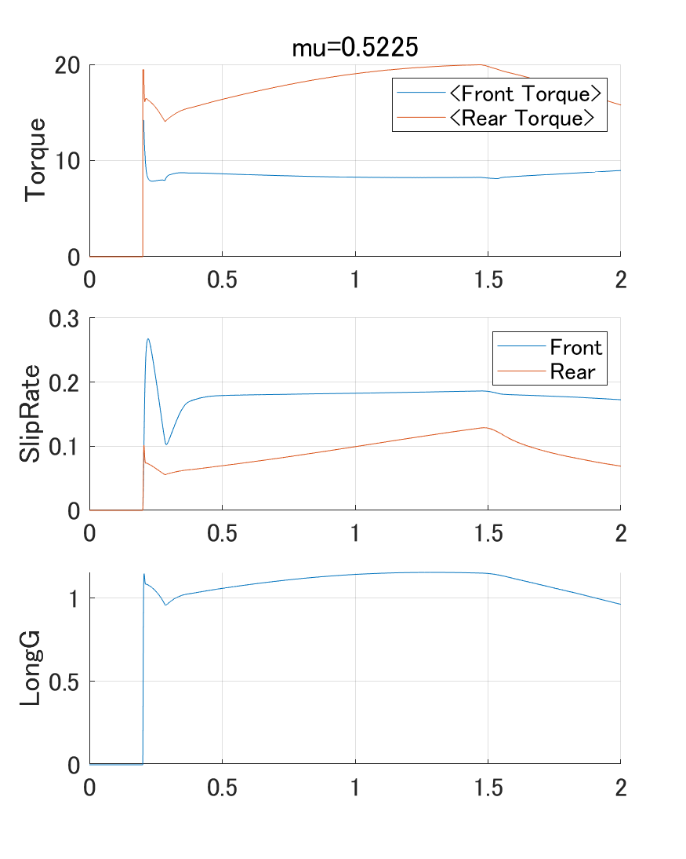
mu difference x0.95

Slide 19
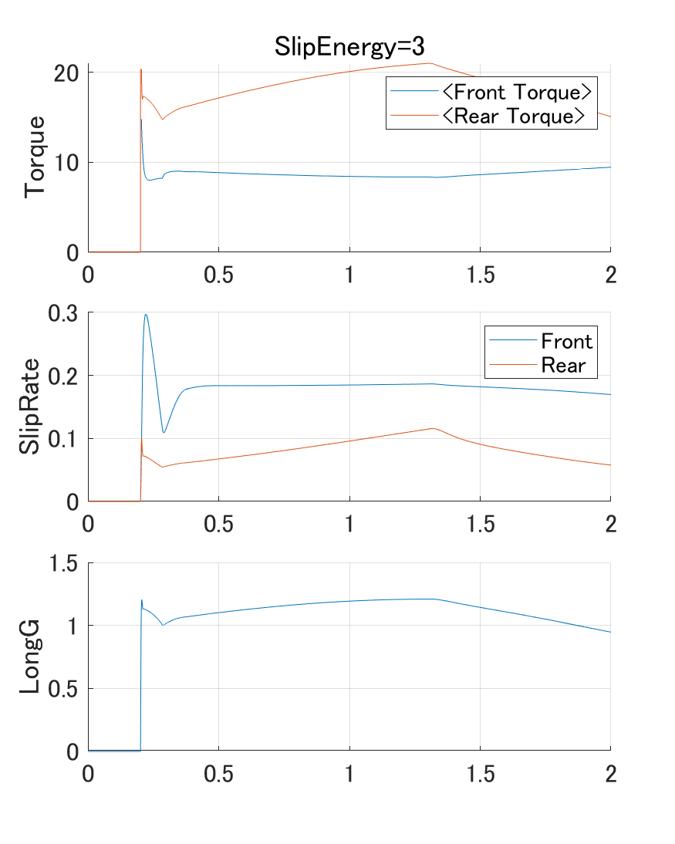
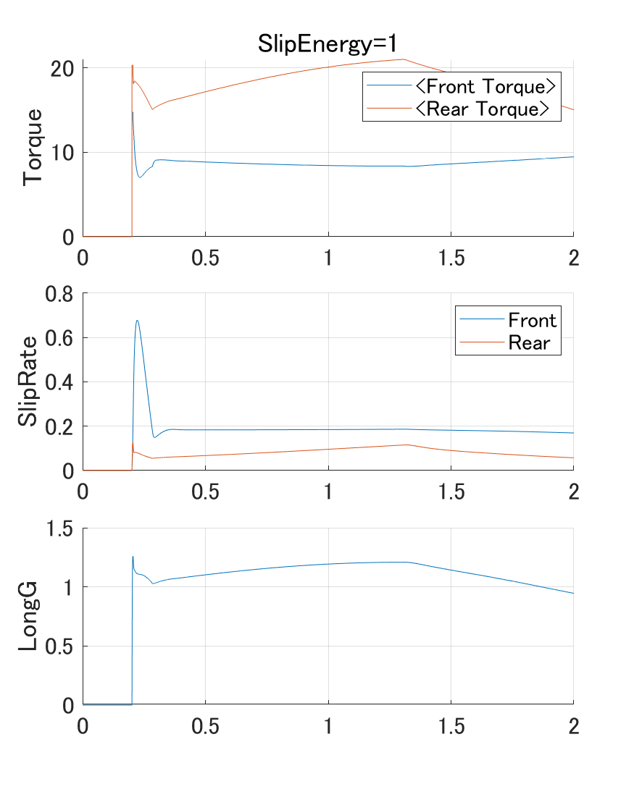
SlipEnergy difference

Slide 20
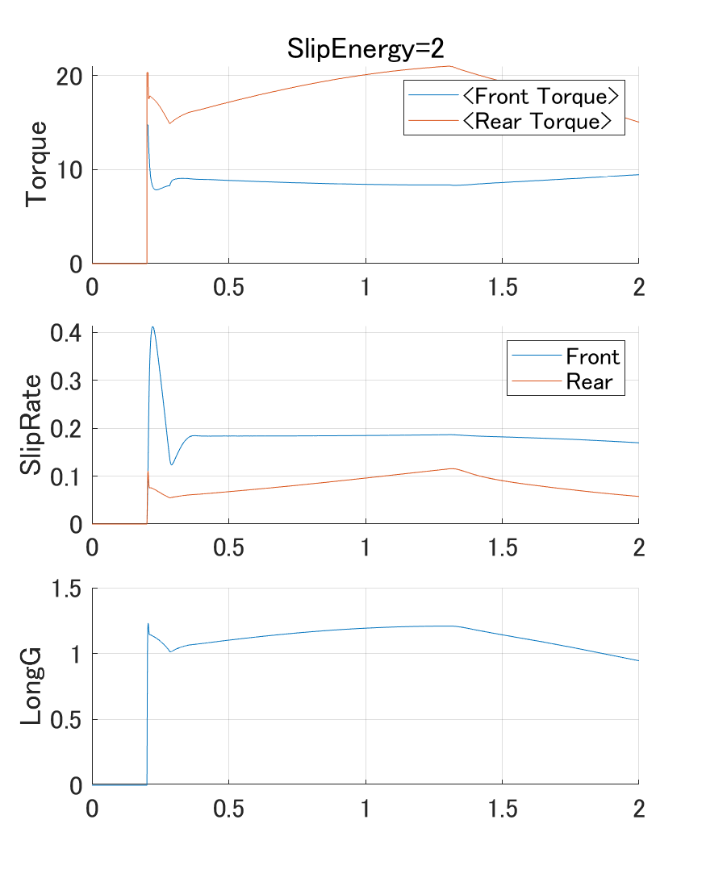
SlipEnergy difference

Slide 21
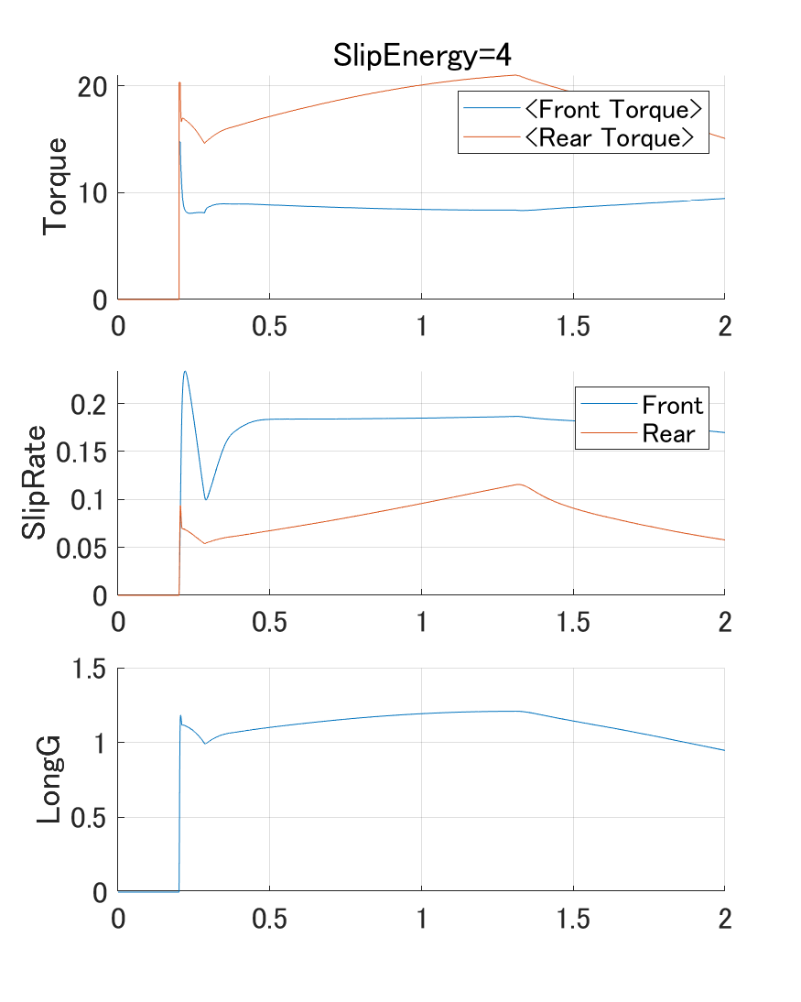
SlipEnergy difference

Slide 22
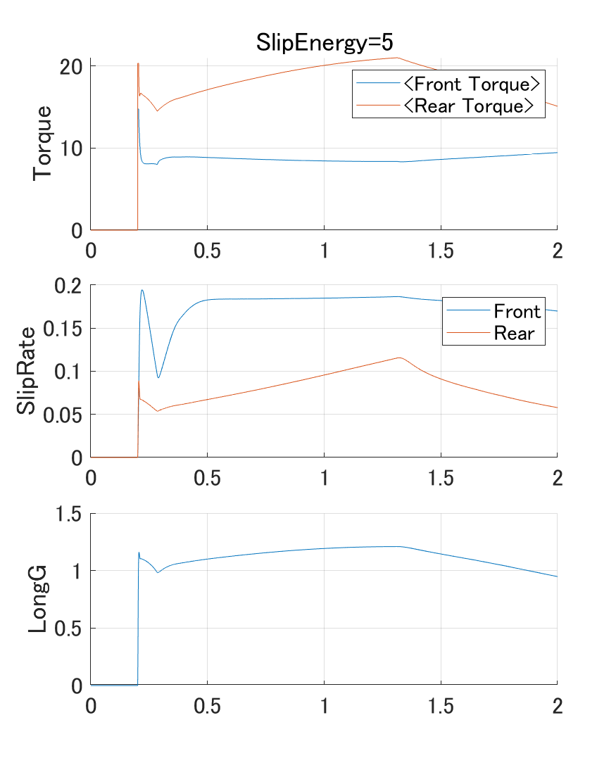
SlipEnergy difference

Slide 23
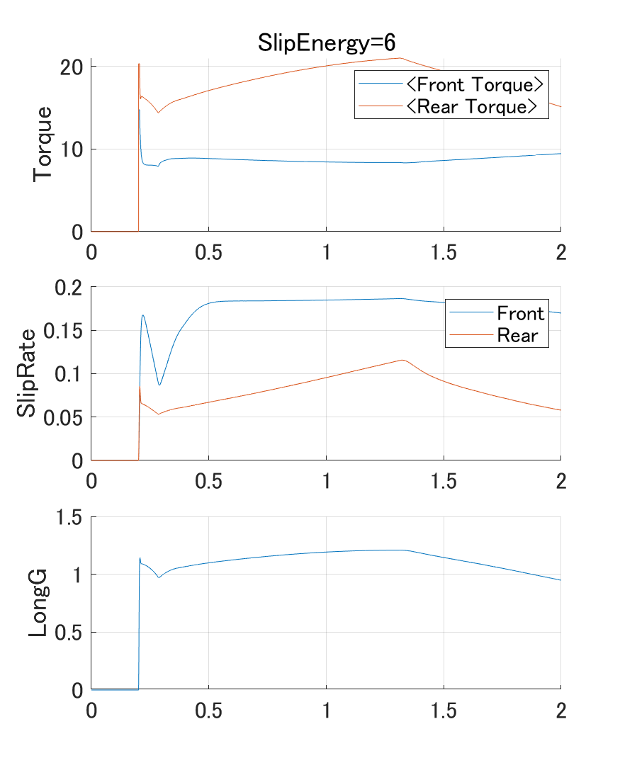
SlipEnergy difference

Slide 24

SlipEnergy difference

Slide 25
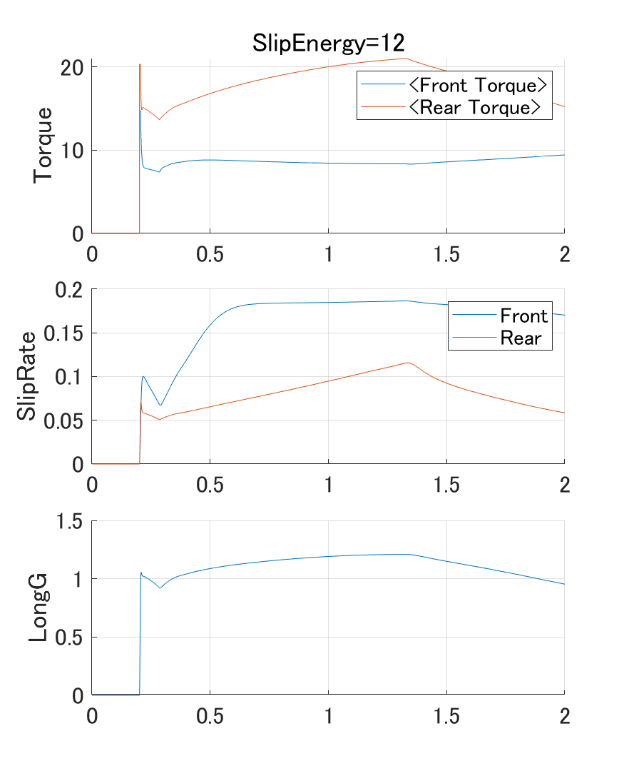
SlipEnergy difference

